Slide 1
Dijkstra’s Algorithm
Avinash Kumar Sharma
Assistant Professor, Department of CSE
ABES Institute of Technology, Ghaziabad

Slide 2

Single-Source Shortest Path Problem
Single-Source Shortest Path Problem - The problem of finding shortest paths from a source vertex v to all other vertices in the graph.

Slide 3


Applications
- Maps (Map Quest, Google Maps)
- Routing Systems

Slide 4
Dijkstra's algorithm
Dijkstra's algorithm - is a solution to the single-source shortest path problem in graph theory.
Works on both directed and undirected graphs. However, all edges must have nonnegative weights.
Input: Weighted graph G={E,V} and source vertex v∈V, such that all edge weights are nonnegative
Output: Lengths of shortest paths (or the shortest paths themselves) from a given source vertex v∈V to all other vertices

Slide 5
Approach
The algorithm computes for each vertex u the distance to u from the start vertex v, that is, the weight of a shortest path between v and u.
the algorithm keeps track of the set of vertices for which the distance has been computed, called the cloud C
Every vertex has a label D associated with it. For any vertex u, D[u] stores an approximation of the distance between v and u. The algorithm will update a D[u] value when it finds a shorter path from v to u.
When a vertex u is added to the cloud, its label D[u] is equal to the actual (final) distance between the starting vertex v and vertex u.

Slide 6

Dijkstra’s Pseudo Code
Graph G, weight function w, root s
relaxing edges

Slide 7
Example: Initialization
Distance(source) = 0
0
∞
Distance (all vertices but source) = ∞
A
2
B
4
1
3
10
∞
C
2
D
2
E
∞
5
8
∞
4
6
F
1
G
∞
∞
Pick vertex in List with minimum distance.

Slide 8
Example: Update neighbors' distance
0
2
A
2
B
4
1
3
10
∞
C
2
D
2
E
∞
5
8
1
4
6
Distance(B) = 2
F
1
G
Distance(D) = 1
∞
∞

Slide 9
Example: Remove vertex with minimum distance
0
2
A
2
B
4
1
3
10
∞
C
2
D
2
E
∞
5
8
1
4
6
F
1
G
∞
∞
Pick vertex in List with minimum distance, i.e., D

Slide 10
Example: Update neighbors
0
2
A
2
B
4
1
3
10
3
C
2
D
2
E
3
5
8
1
4
6
Distance(C) = 1 + 2 = 3 Distance(E) = 1 + 2 = 3 Distance(F) = 1 + 8 = 9 Distance(G) = 1 + 4 = 5
F
1
G
9
5

Slide 11
Example: Continued...
Pick vertex in List with minimum distance (B) and update neighbors
0
2
A
2
B
4
1
3
10
3
C
2
D
2
E
3
5
8
1
4
6
Note : distance(D) not updated since D is already known and distance(E) not updated since it is larger than previously computed
F
1
G
9
5

Slide 12
Example: Continued...
Pick vertex List with minimum distance (E) and update neighbors
0
2
A
2
B
4
1
3
10
3
C
2
D
2
E
3
5
8
1
4
6
F
1
G
No updating
9
5

Slide 13
Example: Continued...
Pick vertex List with minimum distance (C) and update neighbors
0
2
A
2
B
4
1
3
10
3
C
2
D
2
E
3
5
8
1
4
6
Distance(F) = 3 + 5 = 8
F
1
G
8
5

Slide 14
Example: Continued...
Pick vertex List with minimum distance (G) and update neighbors
0
2
A
2
B
4
1
3
10
3
C
2
D
2
E
3
5
8
1
4
6
F
1
G
Previous distance
6
5
Distance(F) = min (8, 5+1) = 6

Slide 15
Example (end)
0
2
A
2
B
4
1
3
10
3
C
2
D
2
E
3
5
8
1
4
6
F
1
G
6
5
Pick vertex not in S with lowest cost (F) and update neighbors

Slide 16

Another Example

Slide 17

Another Example

Slide 18

Another Example

Slide 19

Another Example

Slide 20

Another Example

Slide 21

Another Example

Slide 22

Another Example

Slide 23

Another Example

Slide 24

Another Example

Slide 25

Correctness :“Cloudy” Proof
When a vertex is added to the cloud, it has shortest distance to source.
Least cost node
P: Next shortest path from
inside the known cloud
v
THE KNOWN
CLOUD
competitor
v'
Source
If the path to v is the next shortest path, the path to v' must be at least as long. Therefore, any path through v' to v cannot be shorter!

Slide 26
Time Complexity: Using List
The simplest implementation of the Dijkstra's algorithm stores vertices in an ordinary linked list or array
  Good for dense graphs (many edges)
|V| vertices and |E| edges
Initialization O(|V|)
While loop O(|V|)
  Find and remove min distance vertices O(|V|)
Potentially |E| updates
    Update costs O(1)
Total time O(|V²| + |E|) = O(|V²| )

Slide 27
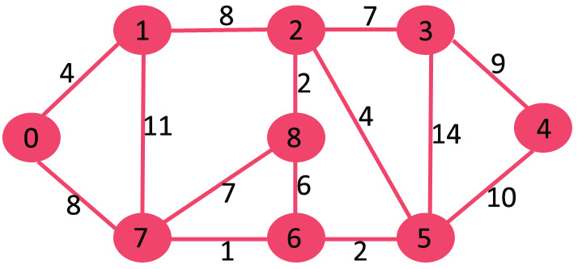
Solve with Dijkstra’s Algorithm for shortest path

Slide 28
Thank You!

